Slide 1
Design of CYBER-SECURITY ENABLED SMART
CONTROLLER for grid-connected Microgrid
CSE7101- Capstone Project
Review-2
Batch Number: CSE_47
Under the Supervision of,
Dr. Manju More E
Associate Professor
School of Computer Science and Engineering
Presidency University
Roll Number | Student Name
20221CSE0121 | Abdul Samad
20221CSE0048 | Siddique Ali Khan
20221CSE0026 | Mohammed Anzal A
Name of the Program: Computer Science & Engineering
Name of the HoD: Dr. Asif Mohammed
Name of the Program Project Coordinator: Dr. Jayavadivel Ravi
Name of the School Project Coordinators: Dr. Sampath A K , Dr. Geetha A

Slide 2
Problem Statement Number:
Organization: Presidency University - Ministry of Power
Category (Hardware / Software / Both) : Software
Problem Description:
Modern microgrids depend heavily on communication networks for control and monitoring, making them vulnerable to cyber-attacks such as False Data Injection (FDI), Denial-of-Service (DoS), and Man-in-the-Middle (MITM) attacks. Current controllers often focus on either performance or security, but lack integrated, real-time resilience mechanisms to ensure stability under attack.

Slide 3
Content
Problem Statement
Abstract
Literature Survey
Objectives
Existing Method and Drawbacks
Proposed Methods & Novelty Feature
Architecture Diagram
Modules
Software Details
Timeline of the Project
References

Slide 4
Abstract
Microgrids are increasingly vulnerable to cyber-attacks such as False Data Injection, Denial of Service, and Man-in-the-Middle, which threaten operational stability. Existing defenses are often studied in isolation, highlighting the need for an integrated real-time platform. This work simulates representative attack scenarios within a microgrid testbed using Linux-based tools for end-to-end validation. Communications are secured with ECC-based mutual authentication and encryption tailored for resource-constrained controllers. A hybrid anomaly detector combines fast residual checks with ML classification to identify attacks in real time. Finally, a lightweight blockchain anchors audit logs and alerts to provide tamper-evident, low-latency forensics for resilient incident response.

Slide 5
Objectives
Problem Statement
Cyber-attacks such as False Data Injection (FDI), Denial of Service (DoS), and Man-in-the-Middle (MITM) pose serious risks to microgrid stability and security.
Existing solutions often focus only on simulations or individual techniques without integrating detection, prevention, and logging in a single real-time platform.
Objectives
Simulate cyber-attacks on a microgrid using Linux-based tools.
Secure communication using ECC encryption.
Detect anomalies using a hybrid approach (threshold + ML).
Log events in a lightweight blockchain.
Develop a React.js dashboard for real-time monitoring and control.

Slide 6
Literature Survey
FDI Attacks – Disrupt microgrid control; hybrid residual + ML detection improves robustness.
DoS/DDoS Attacks – Block telemetry/control; edge detectors must meet real-time limits.
MITM Attacks – Feasible on Modbus/TCP; require authenticated encryption for protection.
ECC Security – Provides strong, efficient authentication and key exchange for energy devices.
Blockchain Logging – Enables tamper-proof event logs with low delay and storage overhead.
Research Gap – Lack of integrated platforms combining simulation, ECC, detection, blockchain, and dashboards.

Slide 7
Existing Method & Limitations
Existing Research
ECC encryption widely applied in IoT secure communication.
Blockchain used for secure logging in energy systems.
ML-based anomaly detection for cyber-physical systems.
Limitations Found
Mostly simulation-only studies without real-time integration.
High computational cost for blockchain on low-power devices.
Single-approach detection methods lacking hybrid intelligence.

Slide 8
Proposed Method and Feasibility Study
Novelty
Integration of ECC encryption, blockchain logging, and hybrid anomaly detection in a single software platform, validated through realistic Linux-based cyber-attacks.
Key Contributions
Lightweight ECC encryption for low-latency secure communication.
Lightweight blockchain for tamper-proof event logging.
Hybrid detection system (threshold + ML) for improved accuracy.
React.js dashboard for real-time visualization and control.
Why Innovative?
Combines multiple proven techniques in a single working prototype.
Optimized for software-only real-time demonstration.
Flexible to extend into hardware in the future.

Slide 9
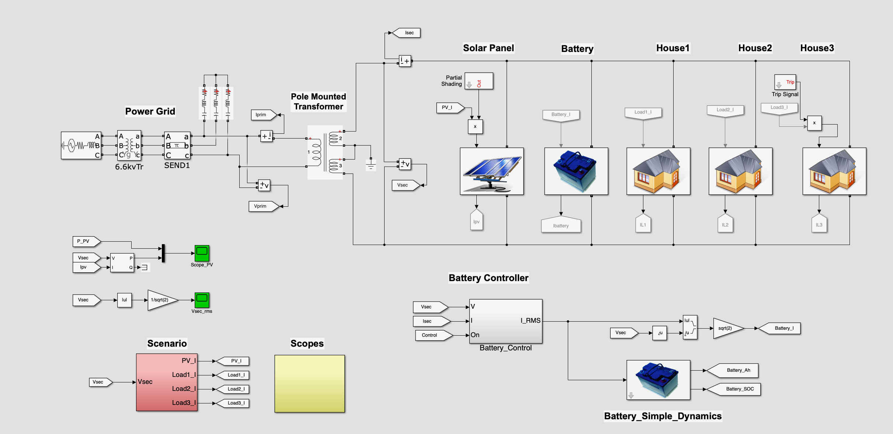
Architecture

Slide 10
Modules
Microgrid Data Acquisition – Streams real-time measurements and control signals for reliable monitoring.
Attack Simulation Engine – Generates FDI, DoS/DDoS, and MITM scenarios to test defenses.
Secure Communication (ECC) – Provides lightweight authentication and encryption for controllers.
Hybrid Anomaly Detection – Uses thresholds and ML to detect and classify attacks in real time.

Slide 11
Modules
Automated Resilience – Applies isolation, rate limits, and fallback controls during attacks.
Blockchain Logger – Records tamper-proof event hashes on-chain with off-chain storage.
Operator Dashboard – Displays live data, attacks, alerts, and logs for incident response.
Data & Key Store – Safely maintains datasets, models, and cryptographic keys for recovery.

Slide 12
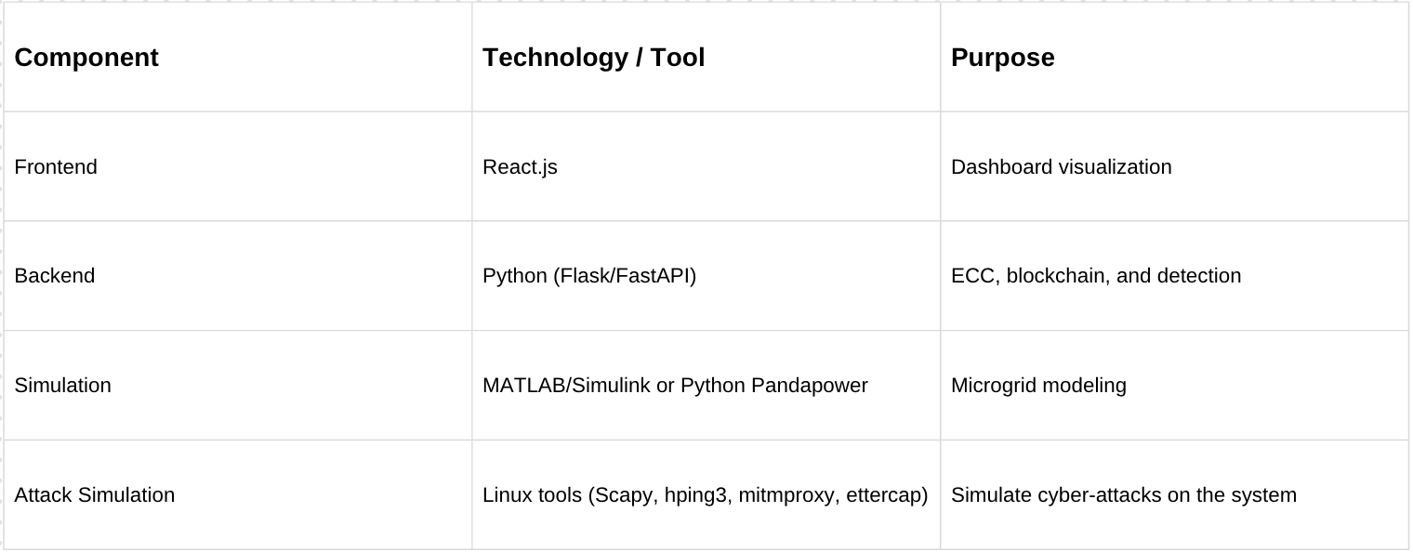
Software Technology Stack
Technology Stack Components:

Slide 13
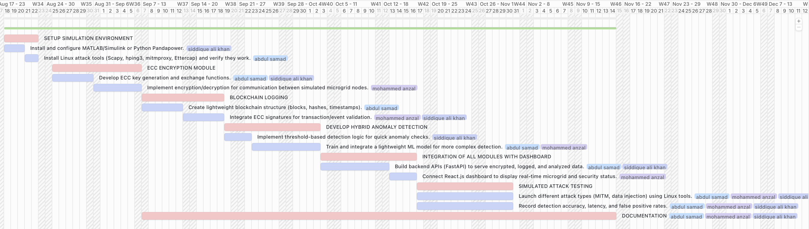

Timeline of the Project (Gantt Chart)
MAIN TASK
SUB - TASK

Slide 14
References (IEEE format)
[1] A. Ayele et al., “Secure Communication in Smart Grids using ECC,” IEEE Transactions on Smart Grid, vol. 14, no. 2, pp. 1021–1032, 2023.
[2] A. Ahmed et al., “Blockchain-based Event Logging for Energy Systems,” Sensors, vol. 22, no. 5, pp. 854–866, 2022.
[3] Y. Wang et al., “Resilient Control of Hybrid Microgrids under Cyber Attacks,” Energy Reports, vol. 10, pp. 112–123, 2024.

Slide 15


